Slide 1
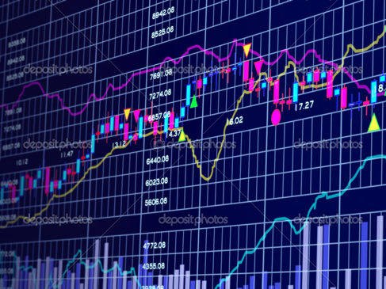
Evaluation of Stock Market Trading Algorithms
Carlos Gattorno
George Murnane
William Tate

Slide 2
Our Goal… Create a profitable stock market trading algorithm using one or more deep learning models
Motivation & Summary

Slide 3
Machine learning models we utilized were:
Random Forest
Long Short-Term Memory (LSTM)
Support Vector Classifier (SVC)
Trading strategies we explored were:
Moving Average of Closing Prices
Exponential Moving Average of Closing Prices
Exponential Moving Average of Daily Return Volatility
Bollinger Band
Buy and Hold
MODEL(s) SUMMARY

Slide 4
We used Yahoo Finance to get the data for Apple stock from 2016/1/6 to 2021/1/5. Our analysis is daily-based, and all the decisions are made using the closing price on the previous day.
In the two models incorporating moving average, our analysis started from 50 days after January 6, 2016 and ended on January 5, 2021 (due to using 50-day moving averages).
We used Yahoo Finance and DataReader to obtain and load trading data for Apple stock.
Data cleanup & Exploration
(All 3 models)

Slide 5
Random Forest Trading Model

Slide 6
Training Steps
Save Trading Signals as a CSV File
Read in CSV as Pandas DataFrame
Set Index, Infer DateTime Format, and Drop Extraneous Columns
Set X-Variable List and Filter to Obtain Associated Values
Shift the DataFrame Index by 1
Drop NAs and Replace Infs (Positive/Negative Infinity)
Construct the Dependent Variable
Assign Training and Testing Windows
Separate X and y Training Datasets
Separate X and y Testing Datasets
Train Random Forest Model
Save Pre-Trained Model Using Joblib
Save X_test and Results dataframes as CSV files
Data cleanup & Exploration (Random Forest)

Slide 7
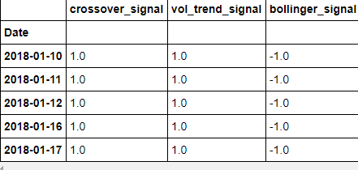
Create a CSV file based on the following trading signals:
Exponential Moving Average of Closing Prices
Exponential Moving Average of Daily Return Volatility
Bollinger Bands
Data cleanup & Exploration (Random Forest)

Slide 8
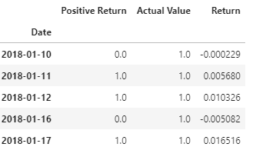
Assigned Training (.75) and Testing (.25) windows
Separate the X and y dataset
Used the Sklearn linear regression
Trained the X_train and y_train
Data Exploration & Training (Random Forest)

Slide 9
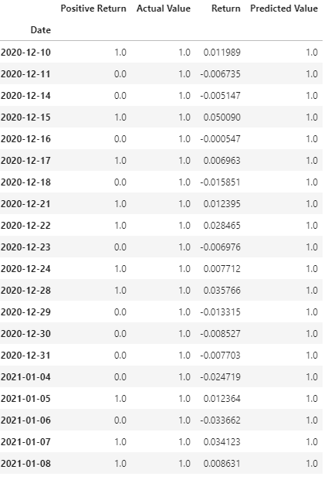
Added Predicted Value
From the first 20 predicted value
20 were actual values
9 positive returns
Best return date was 2/6/2018
From the last 20 predicted value
20 were actual values
10 positive returns
Best return date was 1/7/2021
Training results (Random Forest)

Slide 10
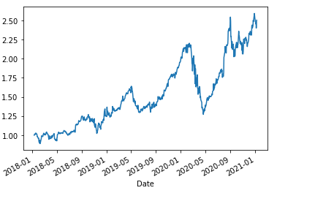
With our Apple stock data, the Predicted model helps to explain when to sell and buy ----- 150% over 3 years.
Model results (Random Forest)

Slide 11
Long Short-Term Memory (LSTM) Model

Slide 12
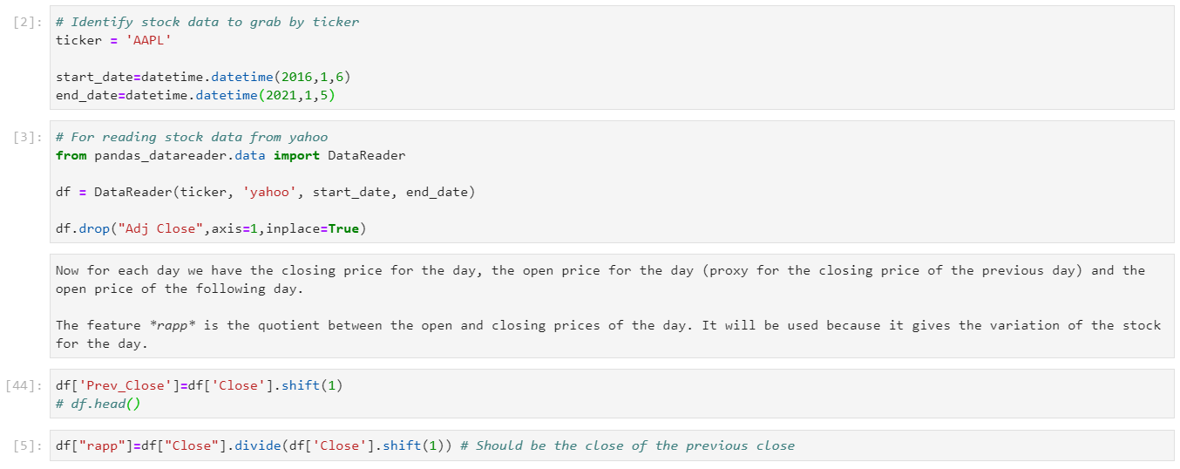
Part 1: Get the data and clean up
Read in stock price data directly from Yahoo as Pandas dataframe
Create ‘Prev_Close’ column
Create ‘rapp’ column
LSTM Model
Data cleanup & Exploration (LSTM)

Slide 13
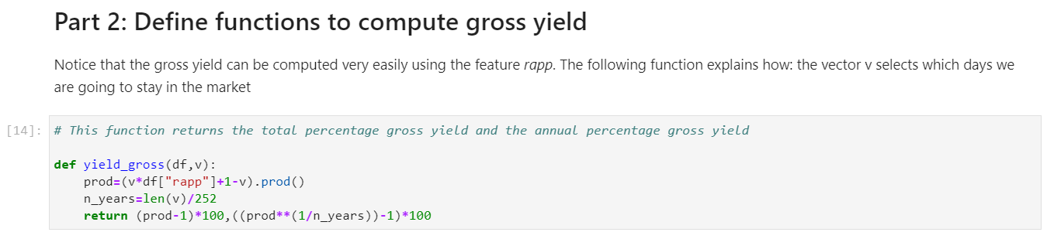
Data cleanup & Exploration (LSTM)

Slide 14
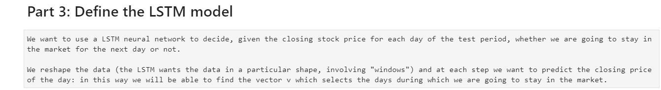
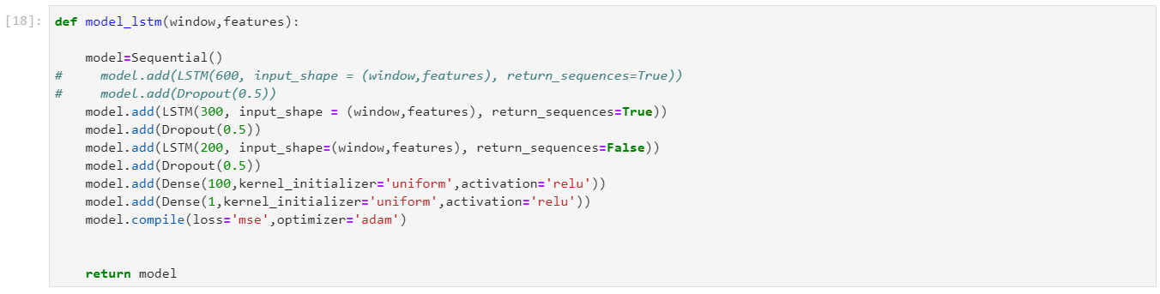
Determine number of epochs to run
Run the model
View the model loss
Data Modeling (LSTM)

Slide 15
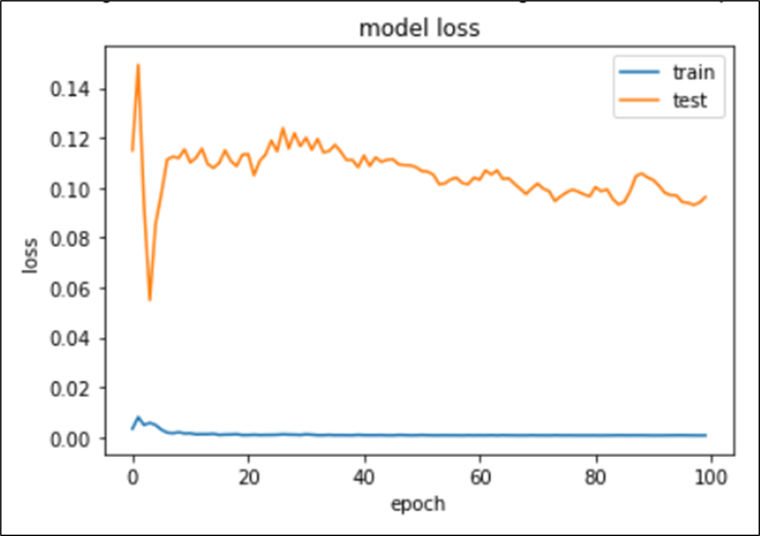
MODEL LOSS (LSTM)

Slide 16
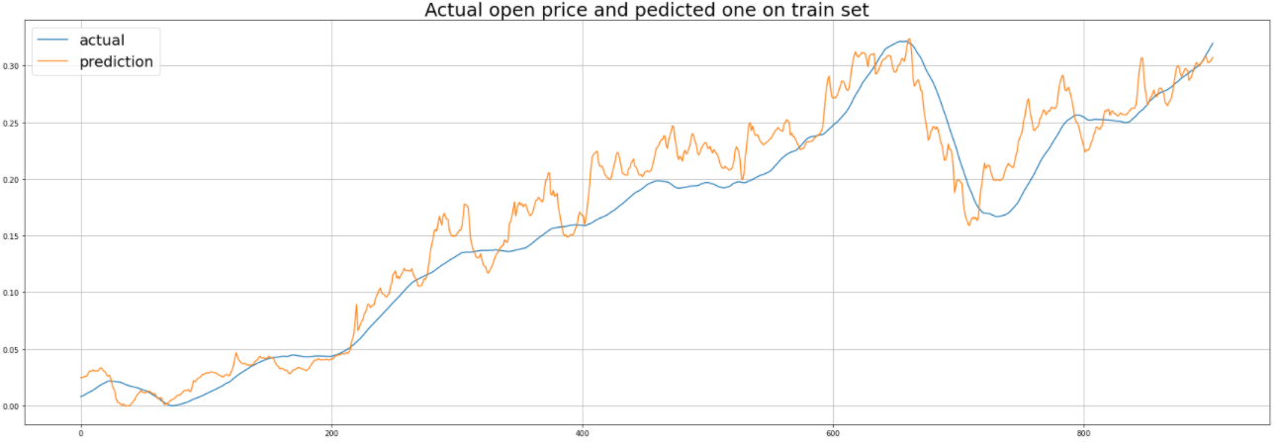
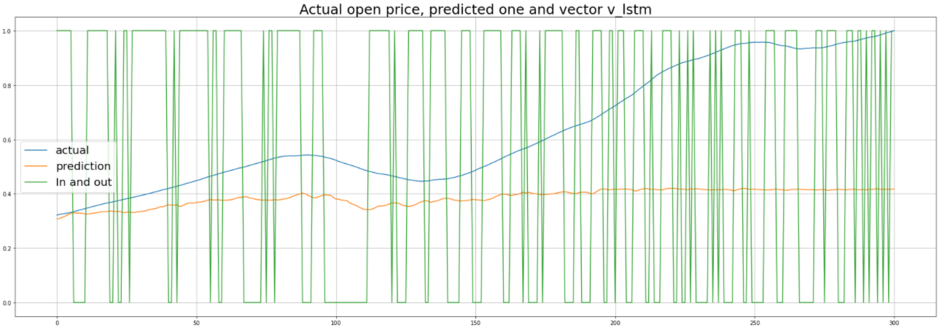
MODEL PREDICTION VS ACTUAL
(LSTM)

Slide 17
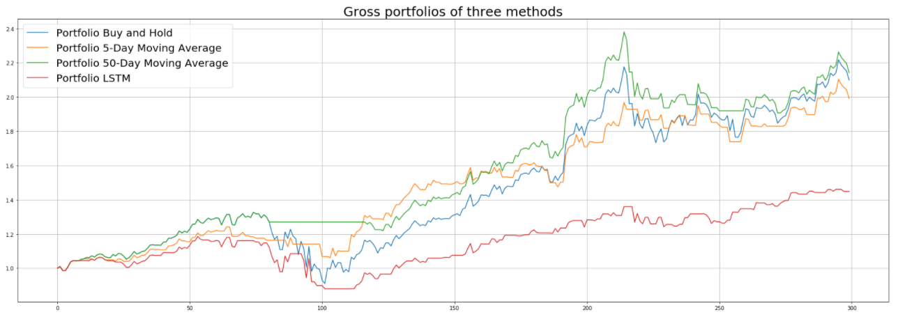
Model evaluation(LSTM)

Slide 18
SUPPORT VECTOR MACHINE

Slide 19
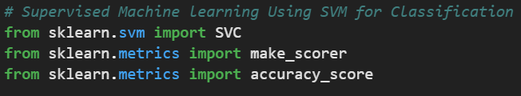
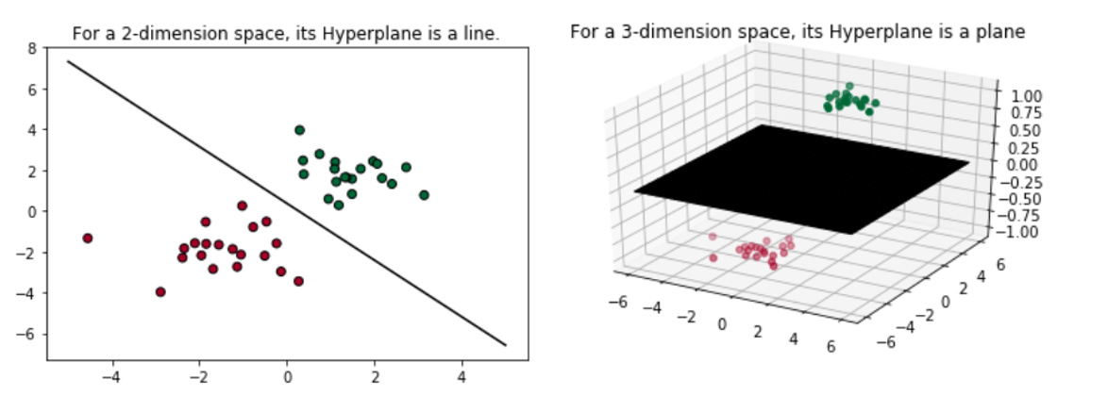
SVM classifies data by finding the best hyperplane that separates all data points of one class from those of the other class
Support Vector Machine

Slide 20

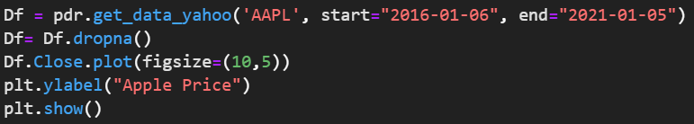
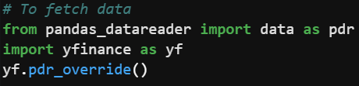
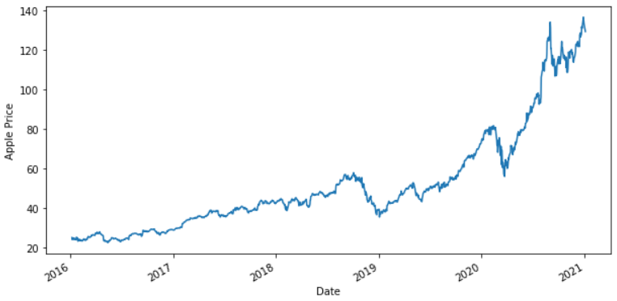
Data Fetch and Preparation(SVM)

Slide 21
Determine the correct trading signal
If tomorrow's price is greater than today's price, then we will buy Apple stock, else we will sell the stock.
We will store +1 for buy signal and -1 for sell signal in the Signal column. 'y' is a target dataset storing the correct trading signal which the machine learning algorithm will try to predict.
Data MODEL(SVM)

Slide 22
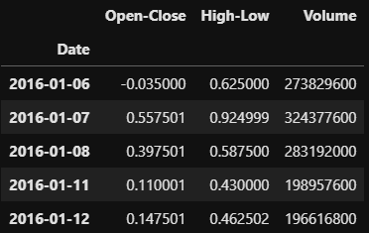
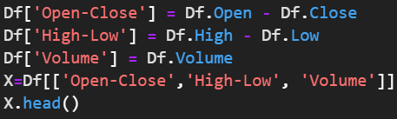
Creation of predictors datasets
The X is a dataset that holds the variables which are used to predict y, that is, whether Apple stock price will go up (+1) or go down (-1) tomorrow. The X consists of variables such as 'Open - Close', 'High - Low' and 'Volume'. These can be understood as indicators based on which the algorithm will predict tomorrow's trend.
Data MODEL(SVM)

Slide 23
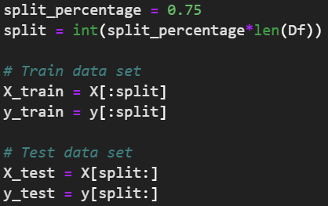

Train and Test Data Split
Training the Model
Model Training (SVM)

Slide 24
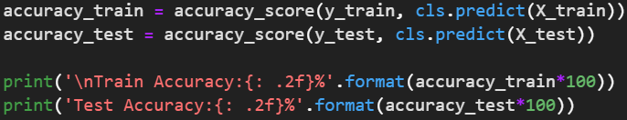
Evaluate Classifier Accuracy
Compute the accuracy of the algorithm on the train and test data set, by comparing the actual values of Signal with the predicted values of Signal.
Train Accuracy: 54.93%
Test Accuracy: 55.24%
An accuracy of 50%+ in test data suggests that the classifier model is effective.
Evaluate the Model (SVM)

Slide 25
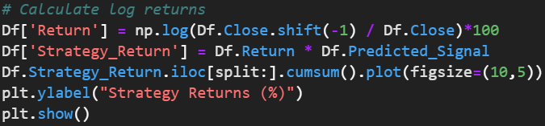
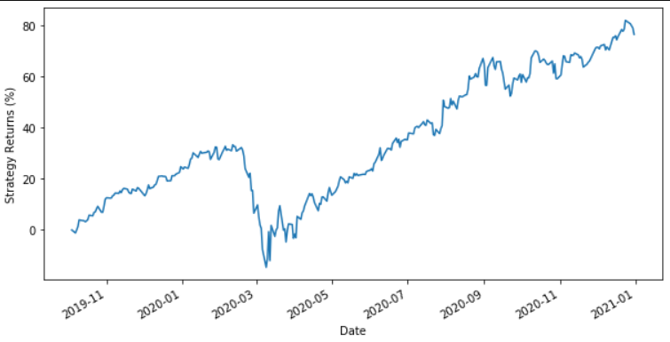
Model predicts the signal (buy or sell) for the test data set using the cls.predict() function.
Model computes the strategy returns based on the predicted signal and then saves it in the column 'Strategy_Return'
As seen from the graph, the strategy generates a return of 75%+ for the test data set.
MODEL PREDICTION (SVM) & STRATEGY IMPLEPLEMENTATION

Slide 26
In conclusion
Random Forest was the most accurate
SVM was the second best
LSTM was the weakest
FINDINGS

Slide 27
Findings
Random Forest /LSTM Models/SVM
Predictive Abilities
Random Forest /LSTM Models/SVM
Issues addressed
Stock price prediction versus trade timing
DISCUSSION / Q&A

